Slide 1
Mortality and Disability Risk Sharing under the OASDI Program in a Stochastic Overlapping Generations Framework
Lakshmi K. Raut
Social Security Administration
Division of Economic Research
Office of Policy

Slide 2
Outline
Disability and Mortality Risks over the life cycle
The value of the OASDI program to individuals: --Annuity role of the OASI program and income smoothing role of the DI program.
  Effect of the program on the mean and variance of asset holdings, earnings, and consumption over the life-cycle. (Program is not purely redistributive)
  Effect of the program on the size of the representative individual’s life-time welfare
  Individual willingness to pay for the protection.
  Macroeconomic effects on capital accumulation and labor supply.
How individuals of different gender, race, education level and occupation encounter those two types of risks and which group benefits relatively more.

Slide 3
Mortality Risks over the life cycle for various groups

Slide 4
Transition Probability of disability Health Status
Table Transition probability for health Status
current | Health Status Next year
year | Normal | Medium | Disabled | Total
Normal | 90.9 | 7.36 | 1.74 | 100.00
Medium | 21.14 | 71.77 | 7.09 | 100.00
Disable | 18.35 | 55.06 | 26.58 | 99.99
Total | 221.29 | 141.55 | 37.15 | 399.99
 | 55.32 | 35.39 | 9.29 | 100.00
Source : Estimated from SIPP

Slide 5
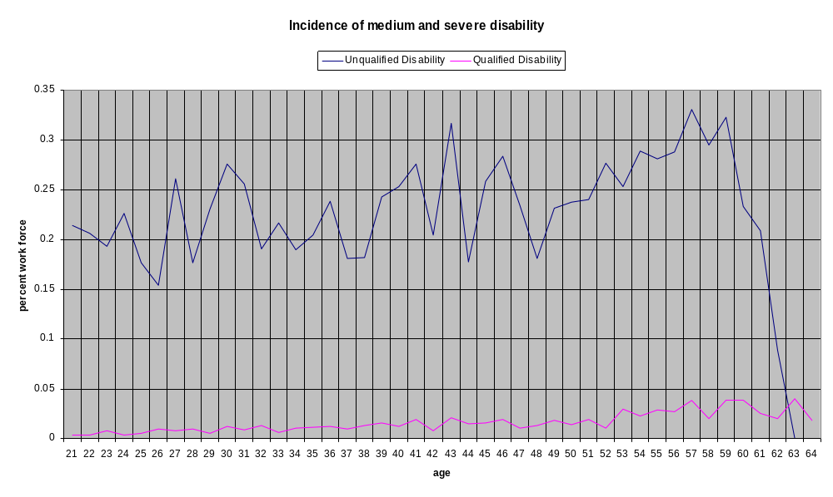
Incidence of Disability

Slide 6
Disability and Productivity

Slide 7
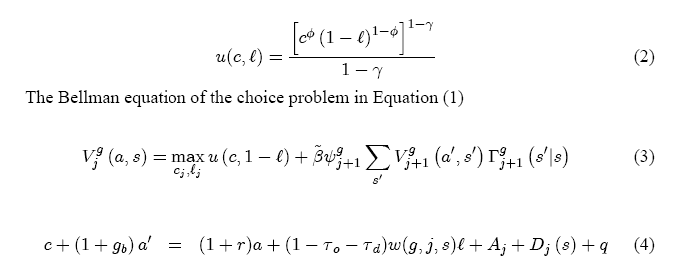
Structure of the Model Economy

Slide 8
Findings
Consider three scenarios: Compare the outcome of existing PAYGO system with OASI replacement rate .4 and DI Replacement Rate .3 with (a) with No OASDI and with the current system if there were no disability and mortality risks.
Effect on mean and variance of consumption, asset holdings (i.e., savings) and earnings. Are the two insurance programs purely redistributive?
Effect on life time welfare
Value to individuals in terms of willingness to pay (under the veil of ignorance, or in private market willingness to pay at age 1, before knowing the health status

Slide 9
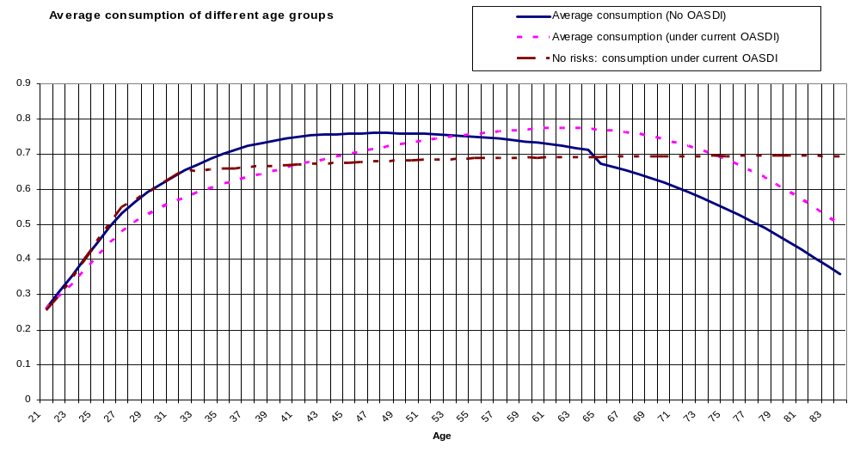
Effect on Consumption (mean)

Slide 10
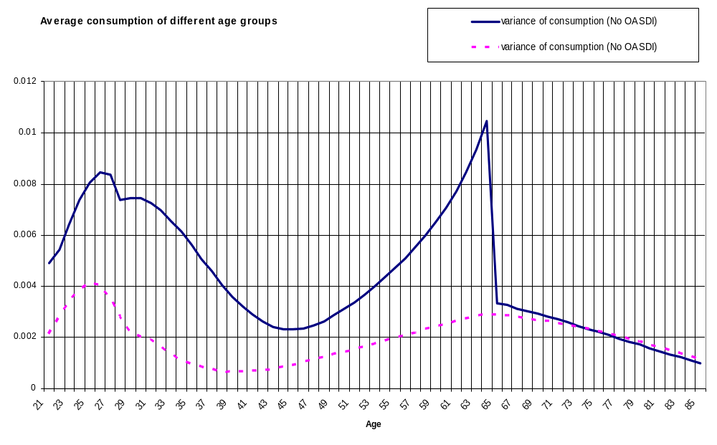
Effect on Consumption variance

Slide 11
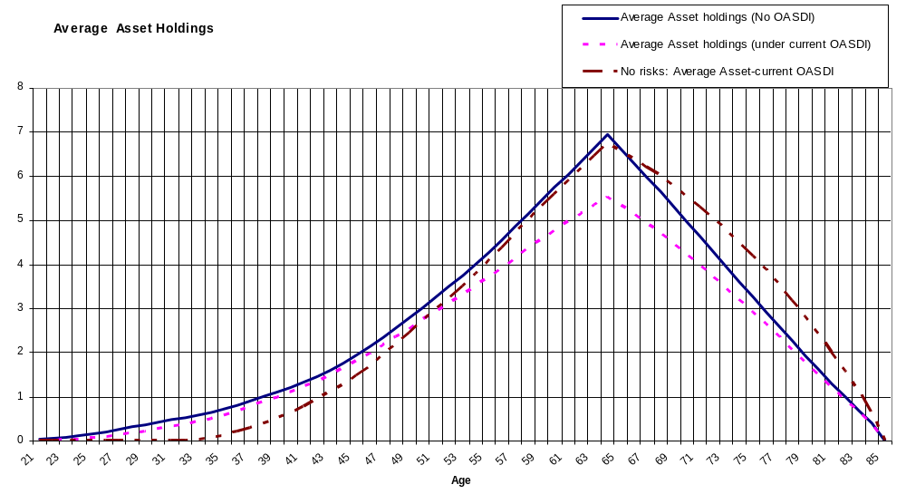
Effect on mean asset holdings

Slide 12
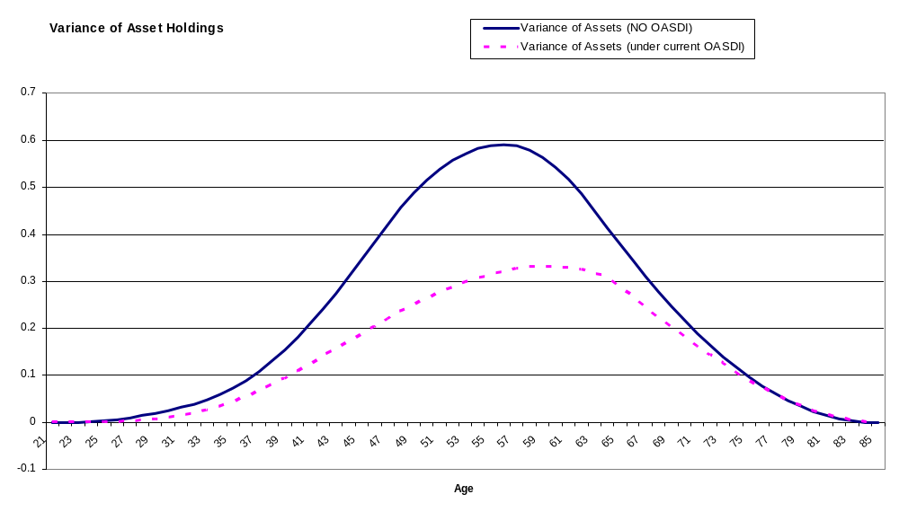
Effect on asset holdings variations

Slide 13
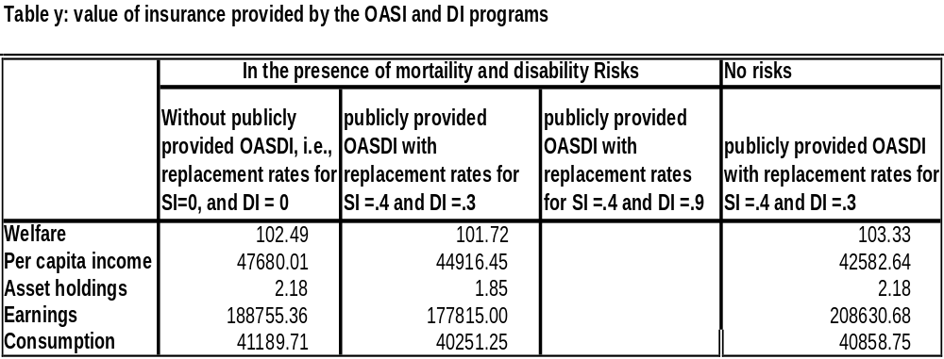
Effect on Life Time Welfare, average savings, consumption and earnings

Slide 14
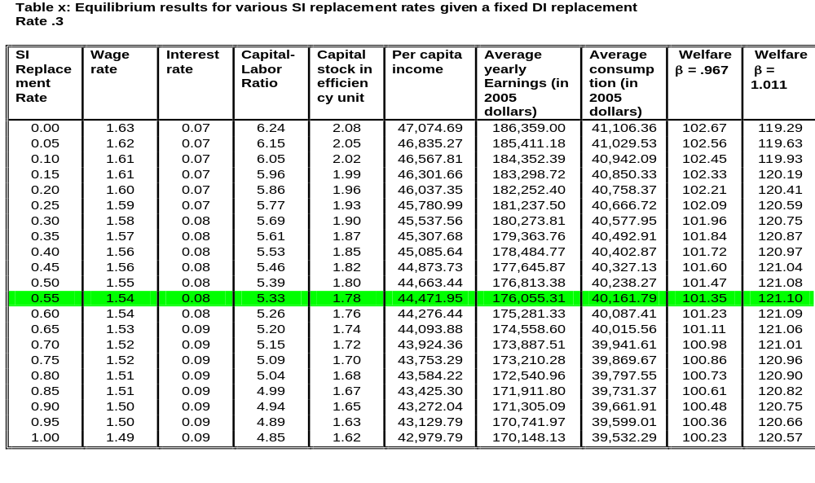
Determination of optimal OASI Rate and willingness to pay for the OASDI Program

Slide 15
Yet to-do

Slide 16
Thank you …

